Slide 1
COMPUTER COMMUNICATION NETWORKS REPORT Topic-ARP poisoning WITH SCAPY
PES1201801939 - Gaurav Rajan
PES1UG19EC329- Tejas mallikarjun
PES1UG19EC345- Venkatesh reddy b c

Slide 2
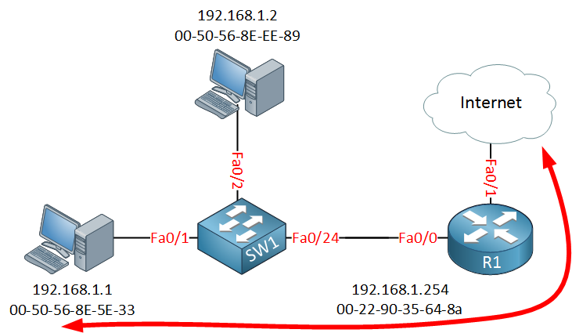
CCN project REPORT
AIM : To demonstrate ARP Poisoning with Scapy using Wireshark

Slide 3
CCN REPORT
The block diagram shown above describes an ARP poisoning. When an ARP query is sent MAC addresses are returned in the response. In case of ARP poisoning when the query is sent, the switch broadcasts which device has the required MAC address. To poison it, we will send false ARP responses by disguising the IP address. The role of Scapy comes here. Scapy is a python module that allows or enables the user to send, sniff, dissect as well as forge the packets. This allows the hacker or the user running the scapy program to have the construction of tools to probe, scan as well as attack the networks.

Slide 4
PROCEDURE :
The attacker’s computer must be running on Kali Linux or Windows
The victim’s computer on Windows
Both the systems must be connected to WLANs (meaning same network)
Run the scapy program by specifying target IP and default gateway
The attacker’s system will send false ARP Responses
Find out the MAC address of the target and the Gateway
Send false response packets to both the target and the gateway.
After the attack, the attacker will store the ARP tables of the victim’s systems

Slide 5
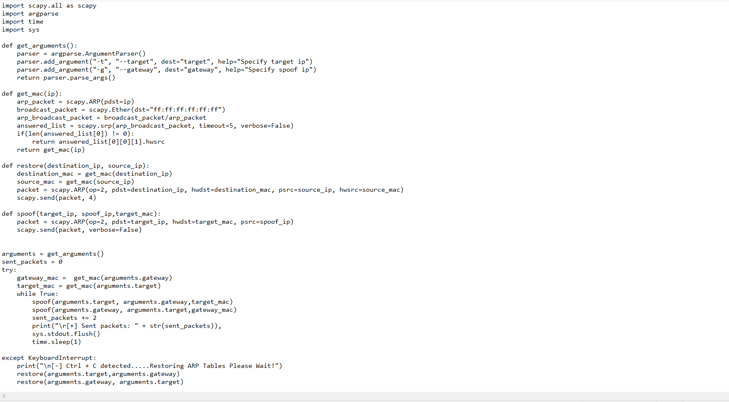
SCAPY PROGRAM :

Slide 6
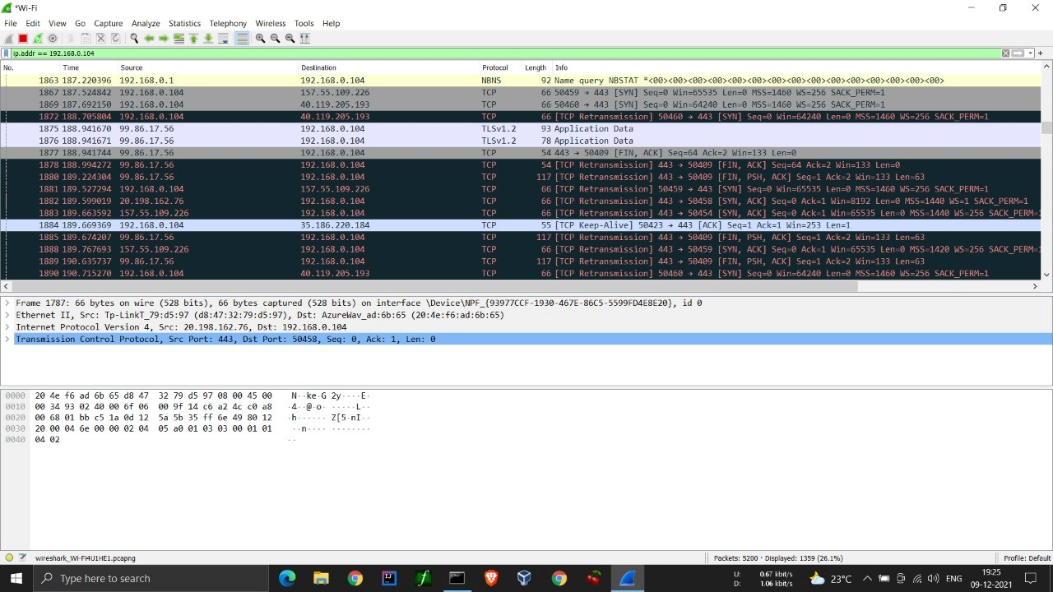
Results :
SCREENSHOTS FROM WIRESHARK :-

Slide 7
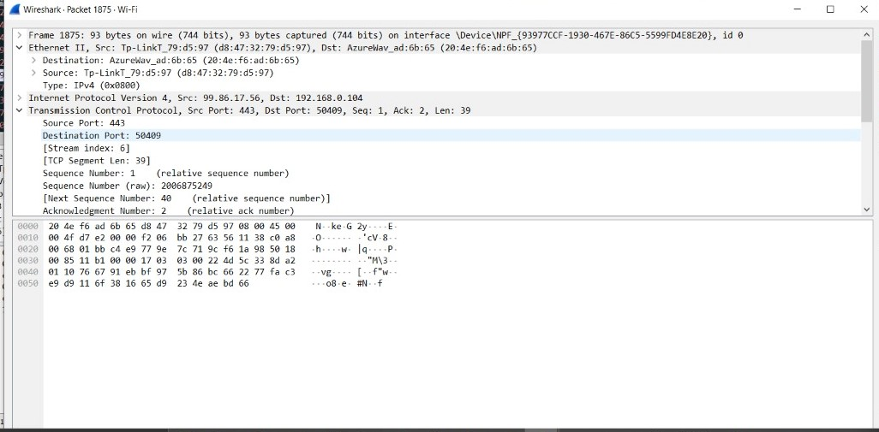

Slide 8
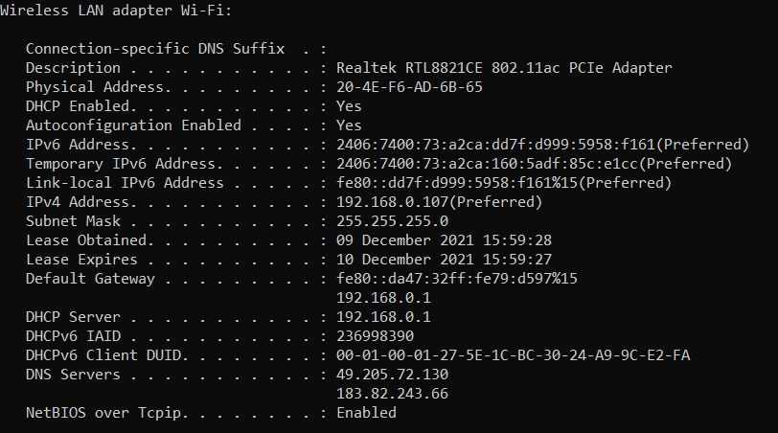
CCN REPORT
ATTACKER’S CONFIGURATION:-

Slide 9
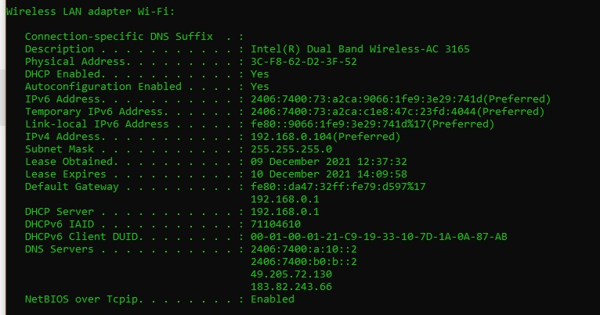
CCN REPORT
VICTIM’S CONFIGURATION :-

Slide 10
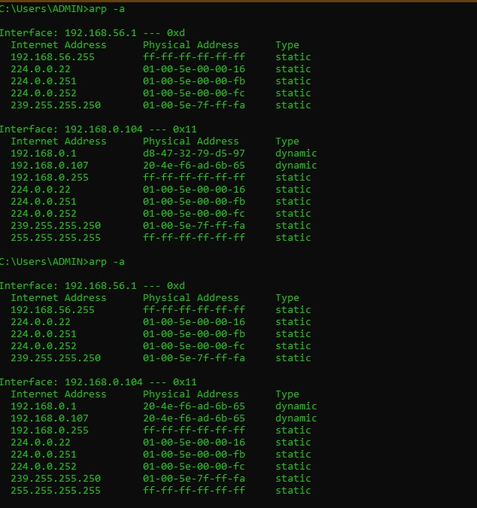
CCN REPORT
ARP CACHE TABLE :-
Before Spoofing
After Spoofing

Slide 11
Observation :
We see that initially in the ARP table of the victim, the MAC address for default gateway was the router’s MAC address (D8-47-32-79-D5-97)
After running the scapy program, the MAC address of default gateway has been changed to the MAC address of the attacker machine (20-4E-F6-AD-6B-65)
Hence, spoofing attempt was successfully done

Slide 12
THANK YOU

